Slide 1
Requirements analysis

Slide 2
Key definitions
The As-Is system is the current system and may or may not be computerized.
The To-Be system is the new system that is based on updated requirements.
The System Proposal is the key deliverable from the Analysis Phase.

Slide 3
Key Ideas
The goal of the analysis phase is to truly understand the requirements of the new system and develop a system that addresses them -- or decide a new system isn’t needed.
The System Proposal is presented to the approval committee via a system walk-through.
Systems analysis incorporates initial systems design.
Requirements determination is the single most critical step of the entire SDLC.

Slide 4
What is a Requirement?
A statement of what the system must do.
A statement of characteristics the system must have.
Focus is on business user needs during analysis phase.
Requirements will change over time as project moves from analysis to design to implementation.

Slide 5
Requirement Types
Functional Requirements
  A process the system has to perform
  Information the system must contain
Nonfunctional Requirements
  Behavioral properties the system must have
    Operational
    Performance
    Security
    Cultural and political

Slide 6
Documenting Requirements
Requirements definition report
  Text document listing requirements in outline form
  Priorities may be included
Key purpose is to define the project scope: what is and is not to be included.

Slide 7
Determining Requirements
Participation by business users is essential.
Three techniques help users discover their needs for the new system:
  Business Process Automation (BPA)
  Business Process Improvement (BPI)
  Business Process Reengineering (BPR)

Slide 8
Determining Requirements
Understand the “As-Is” system.
Identify improvement opportunities.
Develop the “To-Be” system concept.
Techniques vary in amount of change
  BPA – small change
  BPI – moderate change
  BPR – significant change
Additional information gathering techniques are needed as well.

Slide 9
REQUIREMENTS ANALYSIS TECHNIQUES

Slide 10
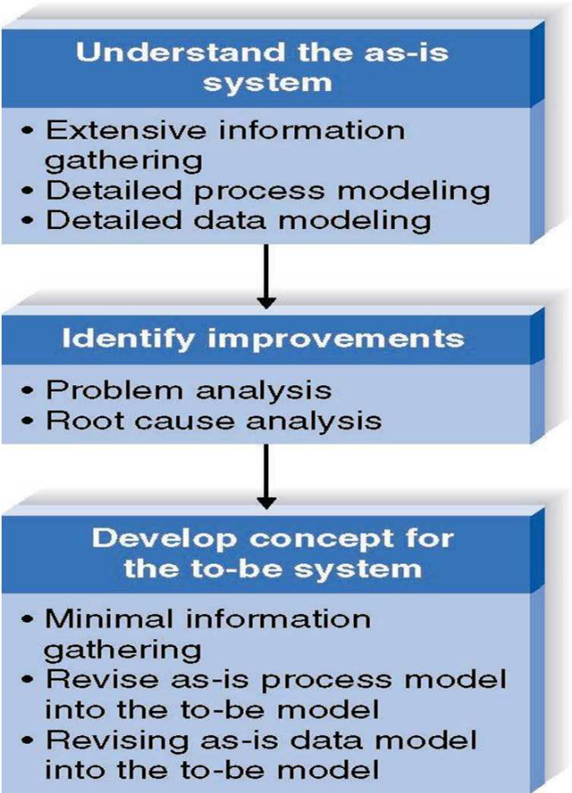
Business Process Automation
Goal:
Efficiency for users

Slide 11
Identifying Improvements in As-Is Systems
Problem Analysis
  Ask users to identify problems and solutions.
  Improvements tend to be small and incremental.
  Rarely finds improvements with significant business value.
Root Cause Analysis
  Challenge assumptions about why problem exists.
  Trace symptoms to their causes to discover the “real” problem.

Slide 12
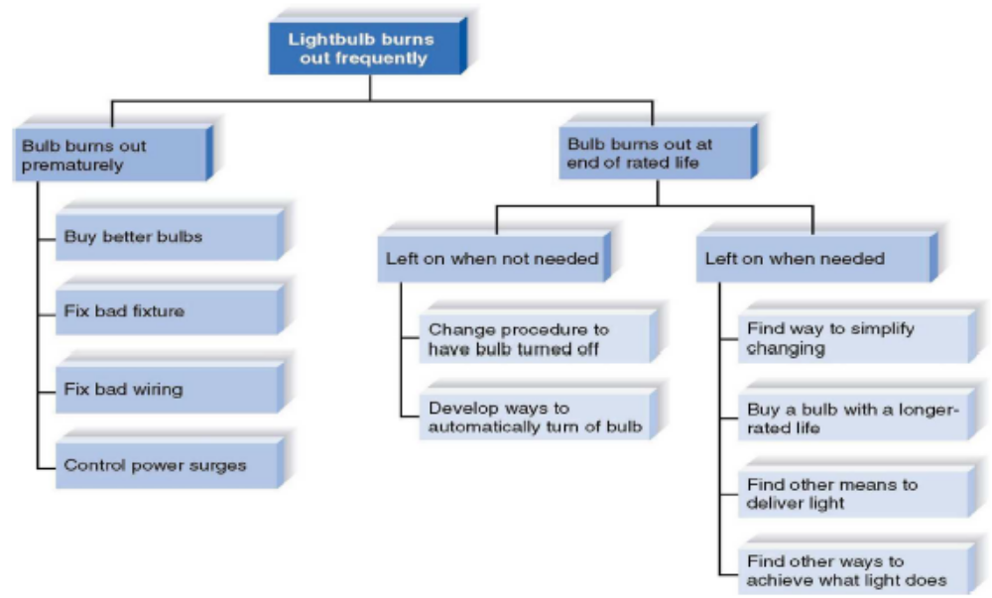
Root Cause Analysis Example

Slide 13
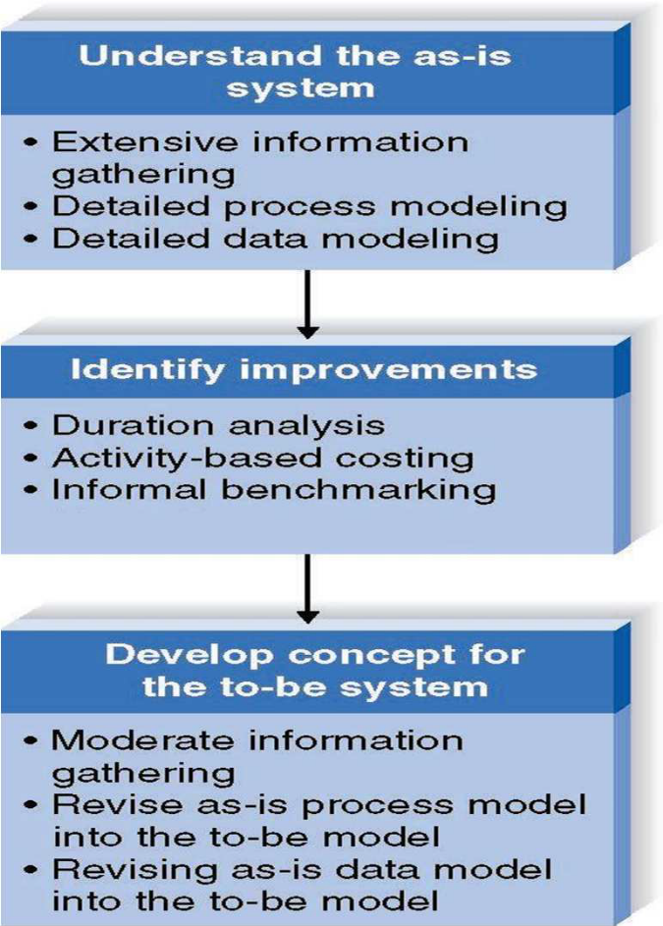
Business Process Improvement
Goal:
Efficiency and effectiveness for users.

Slide 14
Duration Analysis
Calculate time needed for each process step.
Calculate time needed for overall process.
Compare the two – a large difference indicates a badly fragmented process.
Potential solutions
  Process integration – change the process to use fewer people, each with broader responsibilities.
  Parallelization – change the process so that individual step are performed simultaneously.

Slide 15
Activity-Based Costing
Calculate cost of each process step.
Consider both direct and indirect costs.
Identify most costly steps and focus improvement efforts on them.

Slide 16
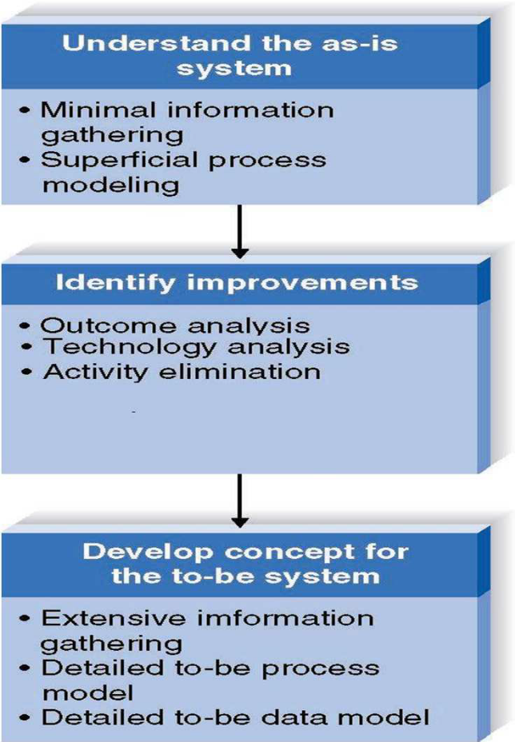
Business Process Reengineering
Goal:
Radical redesign of business processes.

Slide 17
Outcome Analysis
Consider desirable outcomes from customers’ perspective.
Consider what the organization could enable the customer to do.

Slide 18
Technology Analysis
Analysts list important and interesting technologies.
Managers list important and interesting technologies.
The group identifies how each might be applied to the business and how the business might benefit.

Slide 19
Comparing Analysis Techniques
Potential business value
Project cost
Breadth of analysis
Risk

Slide 20
REQUIREMENTS-GATHERING TECHNIQUES

Slide 21
Interviews
Most commonly used technique.
Basic steps:
  Selecting Interviewees.
  Designing Interview Questions.
  Preparing for the Interview.
  Conducting the Interview.
  Post-Interview Follow-up.

Slide 22
Selecting Interviewees
Based on information needs.
Best to get different perspectives.
  Managers
  Users
  Ideally, all key stakeholders
Keep organizational politics in mind.

Slide 23
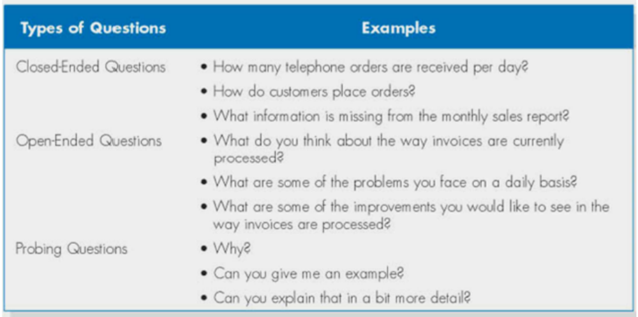
Three Types of Questions

Slide 24
Designing Interview Questions
Unstructured interview useful early in information gathering.
  Goal is broad, roughly defined information
Structured interview useful later in process.
  Goal is very specific information

Slide 25
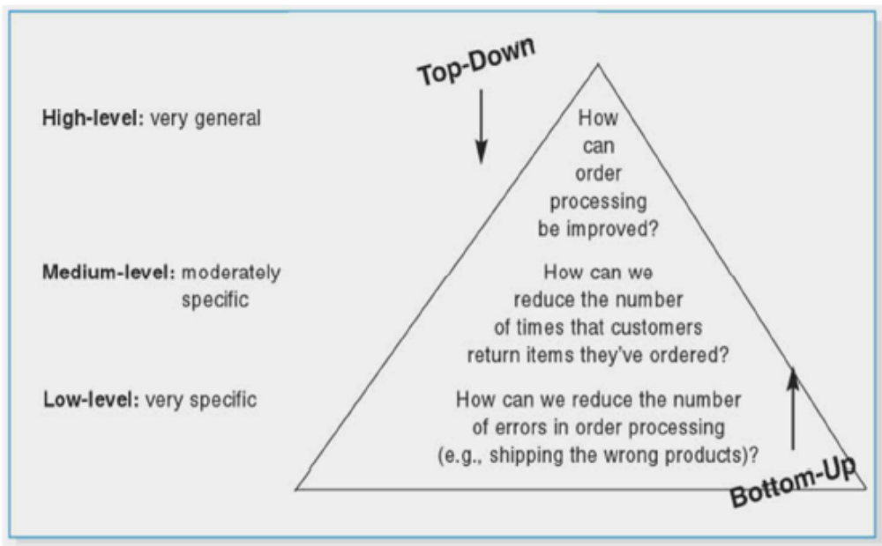
Top-Down and Bottom-up Questioning Strategies

Slide 26
Preparing for the Interview
Prepare general interview plan
  List of question
  Anticipated answers and follow-ups
Confirm areas of knowledge
Set priorities in case of time shortage
Prepare the interviewee
  Schedule
  Inform of reason for interview
  Inform of areas of discussion

Slide 27
Conducting the Interview
Appear professional and unbiased
Record all information
Check on organizational policy regarding tape recording
Be sure you understand all issues and terms
Separate facts from opinions
Give interviewee time to ask questions
Be sure to thank the interviewee
End on time

Slide 28
Post-Interview Follow-Up
Prepare interview notes.
Prepare interview report.
Have interviewee review and confirm interview report.
Look for gaps and new questions.

Slide 29
Joint Application Development (JAD)
A structured group process focused on determining requirements.
Involves project team, users, and management working together.
May reduce scope creep by 50%.
Very useful technique.

Slide 30
JAD Participants
Facilitator
  Trained in JAD techniques
  Sets agenda and guides group processes
Scribe(s)
  Record content of JAD sessions
Users and managers from business area with broad and detailed knowledge

Slide 31
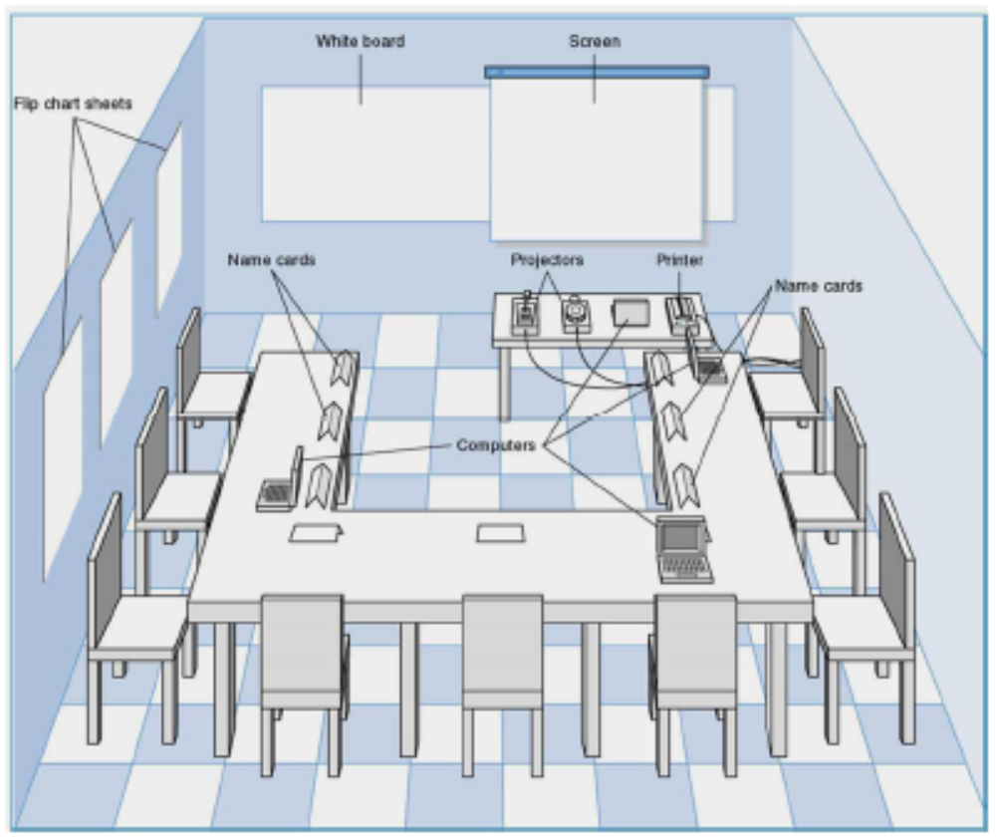
JAD Meeting Room

Slide 32
Conducting the JAD Session
Formal agenda and ground rules
Top-down structure most successful
Facilitator activities
Keep session on track
Help with technical terms and jargon
Record group input
Stay neutral, but help resolve issues
Post-session follow-up report

Slide 33
Post JAD Follow-up
Post session report is prepared and circulated among session attendees.
The report should be completed approximately a week to two after the JAD session.

Slide 34
Questionnaires
A set of written questions, often sent to a large number of people.
May be paper-based or electronic.
Select participants using samples of the population.
Design the questions for clarity and ease of analysis.
Administer the questionnaire and take steps to get a good response rate.
Questionnaire follow-up report.

Slide 35
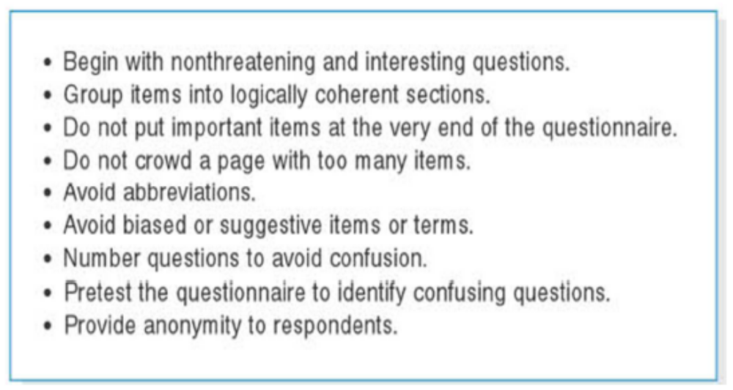
Good Questionnaire Design

Slide 36
Document Analysis
Study of existing material describing the current system.
Forms, reports, policy manuals, organization charts describe the formal system.
Look for the informal system in user additions to forms/report and unused form/report elements.
User changes to existing forms/reports or nonuse of existing forms/reports suggest the system needs modification.

Slide 37
Observation
Watch processes being performed.
Users/managers often don’t accurately recall everything they do.
Checks validity of information gathered other ways.
Be aware that behaviors change when people are watched.
Be unobtrusive.
Identify peak and lull periods.

